Slide 1
The Request/Response Procedure
Every machine attached to the Internet has an IP address—your computer included.
But we generally access web servers by name, such as google.com.
As you probably know, the browser consults an additional Internet service called the Domain Name Service (DNS) to find its associated IP address and then uses it to communicate with the computer.

Slide 2
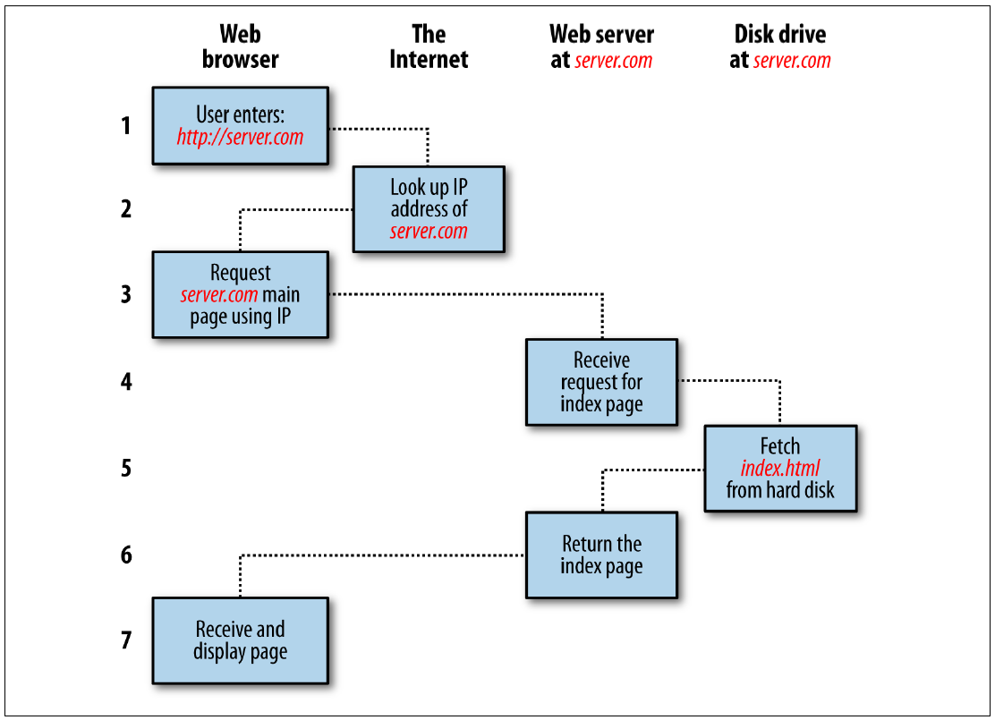
The Request/Response Procedure
Each step in the request and response sequence is as follows:
You enter http://server.com into your browser’s address bar.
Your browser looks up the IP address for server.com.
Your browser issues a request for the home page at server.com.
The request crosses the Internet and arrives at the server.com web server.
The web server, having received the request, looks for the web page on its disk.
The web page is retrieved by the server and returned to the browser.
Your browser displays the web page.

Slide 3
The Request/Response Procedure
For an average web page, this process takes place once for each object within the page:
Graphic, an embedded video, and even a CSS template.

Slide 4
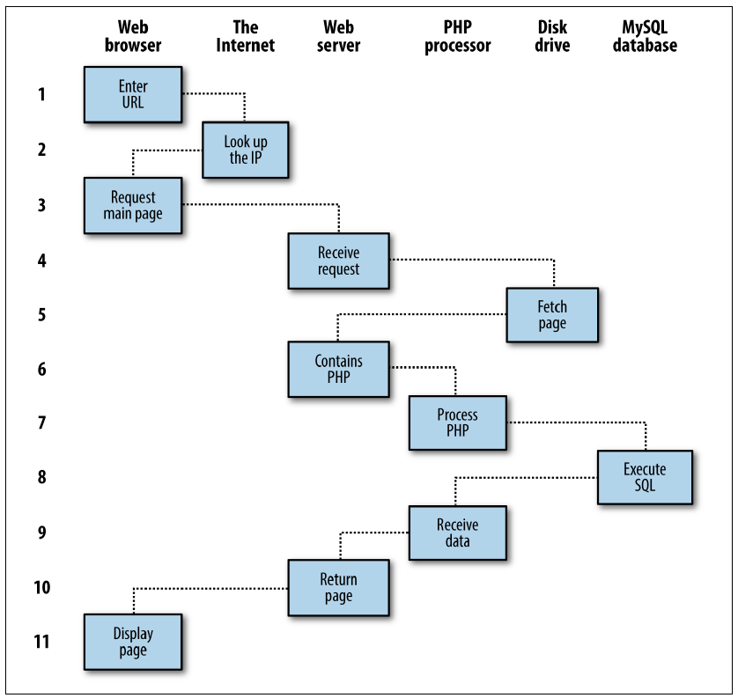
For dynamic web pages, the procedure is a little more involved, because it may bring both PHP and MySQL into the mix
You enter http://server.com into your browser’s address bar.
Your browser looks up the IP address for server.com.
Your browser issues a request to that address for the web server’s home page.
The request crosses the Internet and arrives at the server.com web server.
The web server, having received the request, fetches the home page from its hard disk.
With the home page now in memory, the web server notices that it is a file incorporating PHP scripting and passes the page to the PHP interpreter.
The PHP interpreter executes the PHP code.
Some of the PHP contains MySQL statements, which the PHP interpreter now passes to the MySQL database engine.
The MySQL database returns the results of the statements to the PHP interpreter.
The PHP interpreter returns the results of the executed PHP code, along with the results from the MySQL database, to the web server.
The web server returns the page to the requesting client, which displays it.

Slide 5
HTML pages returned to the browser in each example may well contain JavaScript, which will be interpreted locally by the client, and which could initiate another request—the same way embedded objects such as images would.

Slide 6
PHP
When you give pages the .php extension, they have instant access to the scripting language.
From a developer’s point of view, all you have to do is write code such as the following:
<?php
echo " Today is " . date("l") . ". ";
?>
Here's the latest news.
The opening <?php tells the web server to allow the PHP program to interpret all the following code up to the ?> tag.
Outside of this construct, everything is sent to the client as direct HTML.
So the text Here's the latest news. is simply output to the browser.
Within the PHP tags, the built-in date function displays the current day of the week according to the server’s system time
Today is Wednesday. Here's the latest news.

Slide 7
PHP
PHP is a flexible language, and some people prefer to place the PHP construct directly next to PHP code, like this:
Today is <?php echo date("l"); ?>. Here's the latest news.
Today is Wednesday. Here's the latest news.

Slide 8
MySQL
The highest level of MySQL structure is a database, within which you can have one or more tables that contain your data.
For example, let’s suppose you are working on a table called users, within which you have created columns for surname, firstname, and email, and you now wish to add another user.
One command that you might use to do this is as follows:
INSERT INTO users VALUES('Smith', 'John', 'jsmith@mysite.com’);

Slide 9
MySQL
INSERT is an example of Structured Query Language (SQL), a language designed in the early 1970s and reminiscent of one of the oldest programming languages, COBOL.
It is well suited, however, to database queries, which is why it is still in use after all this time

Slide 10
MySQL
It’s equally easy to look up data.
Let’s assume that you have an email address for a user and need to look up that person’s name.
To do this, you could issue a MySQL query such as the following:
SELECT surname,firstname FROM users WHERE email='jsmith@mysite.com’;
MySQL will then return Smith, John and any other pairs of names that may be associated with that email address in the database.

Slide 11
PHP to MySQL
Using PHP, you can make these calls (and much more) directly to MySQL without having to run the MySQL program yourself or use its command-line interface.
This means you can save the results in arrays for processing and perform multiple lookups, each dependent on the results returned from earlier ones, to drill down to the item of data you need.
For even more power, as you’ll see later, there are additional functions built right into MySQL that you can call up for common operations and extra speed.

Slide 12
JavaScript
Combined with CSS, JavaScript is the power behind dynamic web pages that change in front of your eyes rather than when a new page is returned by the server.
However, JavaScript can also be tricky to use, due to some major differences in the ways different browser designers have chosen to implement it.
This mainly came about when some manufacturers tried to put additional functionality into their browsers at the expense of compatibility with their rivals.

Slide 13
JavaScript
Thankfully, the developers have mostly now come to their senses and have realized the need for full compatibility with one another, so they don’t have to write multiexception code.
But there remain millions of legacy browsers that will be in use for a good many years to come…

Slide 14
JavaScript
For now, let’s take a look at how to use basic JavaScript, accepted by all browsers:
<script type="text/javascript">
document.write("Today is " + Date() );
</script>
Today is Sun Jan 01 2017 01:23:45
This code snippet tells the web browser to interpret everything within the script tags as JavaScript
The browser then does by writing the text Today is to the current document, along with the date, by using the JavaScript function Date.
Unless you need to specify an exact version of JavaScript, you can normally omit the type="text/javascript" and just use <script>
to start the interpretation of the JavaScript.

Slide 15
Ajax
JavaScript was originally developed to offer dynamic control over the various elements within an HTML document, and that is still its main use.
But more and more, JavaScript is being used for Ajax
This is a term for the process of accessing the web server in the background. (It originally meant Asynchronous JavaScript and XML, but that phrase is already a bit outdated.)

Slide 16
Ajax
Ajax is the main process behind what is now known as Web 2.0
In which web pages have started to resemble standalone programs, because they don’t have to be reloaded in their entirety.
Instead, a quick Ajax call can pull in and update a single element on a web page, such as changing your photograph on a social networking site or replacing a button that you click with the answer to a question

Slide 17
CSS
With the emergence of the CSS3 standard in recent years, CSS now offers a level of dynamic interactivity previously supported only by JavaScript.
For example, not only can you style any HTML element to change its dimensions, colors, borders, spacing, and so on, but now you can also add animated transitions and transformations to your web pages, using only a few lines of CSS.

Slide 18
CSS
Using CSS can be as simple as inserting a few rules between <style> and </style> tags in the head of a web page, like this:
<style>
p {
text-align:justify;
font-family:Helvetica;
}
</style>
These rules will change the default text alignment of the <p> tag so that paragraphs contained in it will be fully justified and will use the Helvetica font.

Slide 19
HTML5
As useful as all these additions to the web standards became, they were not enough for ever more ambitious developers.
For example, there was still no simple way to manipulate graphics in a web browser without resorting to plug-ins such as Flash.
And the same went for inserting audio and video into web pages

Slide 20
HTML5
So, to clear all this up and take the Internet beyond Web 2.0 and into its next iteration, a new standard for HTML was created to address all these shortcomings.
It was called HTML5 and it began development as long ago as 2004, when the first draft was drawn up by the Mozilla Foundation and Opera Software
But it wasn’t until the start of 2013 that the final draft was submitted to the World Wide Web Consortium (W3C), the international governing body for web standards.

Slide 21
HTML5
There’s actually a great deal of new stuff in HTML (and quite a few things that have been changed or removed), but in summary, here’s what you get:
Markup
Including new elements such as <nav> and <footer>, and deprecated elements like <font> and <center>.
New APIs
Such as the <canvas> element for writing and drawing on a graphics canvas, <audio> and <video> elements, offline web applications, microdata, and local storage.
Applications
Including two new rendering technologies: MathML (Math Markup Language) for displaying mathematical formulae and SVG (Scalable Vector Graphics) for creating graphical elements outside of the new <canvas> element.

Slide 22
The Apache Web Server
We’ve discussed a little of what a web server does during the HTTP server/client exchange, but it does much more behind the scenes.
For example, Apache doesn’t serve up just HTML files—it handles a wide range of files (images, MP3 audio files, Really Simple Syndication aka RSS, …)
To do this, each element a web client encounters in an HTML page is also requested from the server, which then serves it up.

Slide 23
The Apache Web Server
Apache also supports a huge range of modules of its own.
In addition to the PHP module, the most important for your purposes as a web programmer are the modules that handle security.

Slide 24
Open Source
All these programs are free to use.
There’s no worrying about having to purchase additional licenses if you have to scale up your website and add more servers
And what about security?
It’s complicate…

Slide 25
Real life Example - Gmail
Gmail uses Ajax to check the availability of usernames. The steps involved in this Ajax process would be similar to the following:
The server outputs the HTML to create the web form
This asks for the necessary details, such as username, first name, last name, and email address.
At the same time, the server attaches some JavaScript to the HTML to monitor the username input box and check for two things:
Whether some text has been typed into it
Whether the input has been deselected because the user has clicked on another input box.
Once the text has been entered and the field deselected, in the background the JavaScript code passes the username that was entered back to a PHP script on the web server and awaits a response.

Slide 26
Real life Example - Gmail
The web server looks up the username and replies back to the JavaScript regarding whether that name has already been taken.
The JavaScript then places an indication next to the username input box to show whether the name is one available to the user
If the username is not available and the user still submits the form, the JavaScript interrupts the submission
Optionally, an improved version of this process could even look at the username requested by the user and suggest an alternative that is currently available.

